Slide 1
Microsoft Movie Recommendations
Charlotte Basch with Rachel Beery

Slide 2
Methods
Data were gathered from IMDB, TMDB, and The Numbers
Information about movie title, profit, domestic and worldwide gross, runtime, and IMDB user ratings was collected.

Slide 3

$42.5B
46,504,883
148,474,440
2019 Global Box Office
Mean Budget
Mean Gross Profit
https://www.billboard.com/articles/news/8547827/2019-global-box-office-revenue-hit-record-425b-despite-4-percent-dip-in-us#:~:text=Global%20box%20office%20revenue%20hit%20a%20record%20%2442.5%20billion%20in,%2411.88%20billion%2C%20according%20to%20Comscore.

Slide 4
Questions
What genres are the most profitable?
Do movie ratings affect profitability?
Does a movie’s runtime affect profitability?

Slide 5
What genres are the most profitable?
1

Slide 6
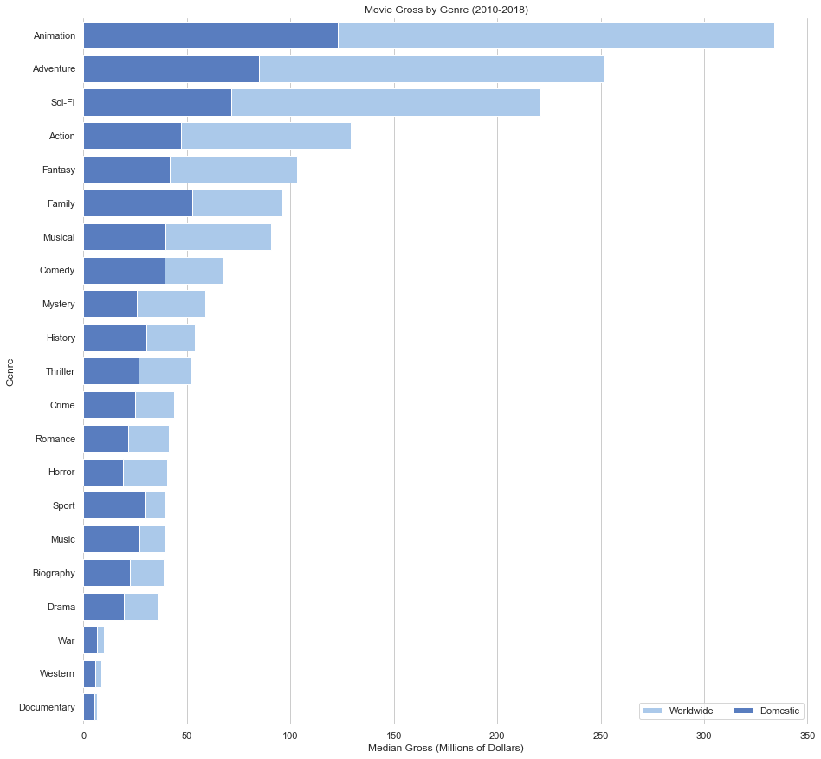
How much money has each genre made?
Adventure, animation, sci-fi, and action are the most profitable genres domestically and internationally.
I recommend focusing on these genres to make the majority of your profit.

Slide 7
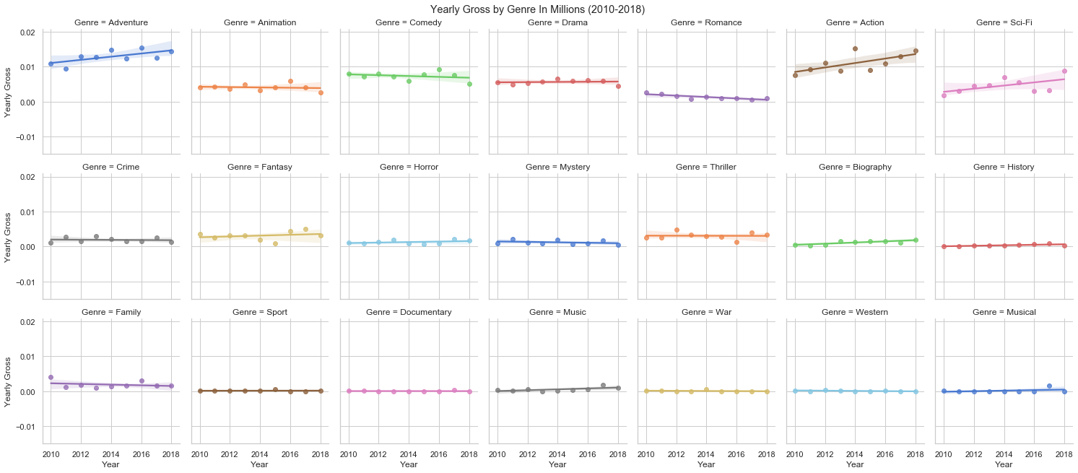
The current highest grossing genres are on track to continue their profitability.
Action and adventure movies are the most profitable. Animation, sci-fi, and other genres also show a positive return of investment.

Slide 8
Do movie ratings affect profitability?
2

Slide 9
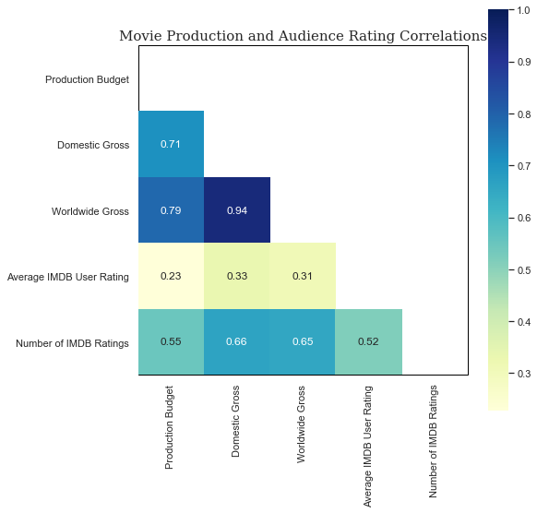
User Ratings (i.e. whether people think the movie is good) are not strongly related to profit or increased budget.
There is not a strong positive correlation between movie ratings and gross profitability.
I do not recommend using subjective user ratings, which consist of a small portion of moviegoers, to make decisions.

Slide 10
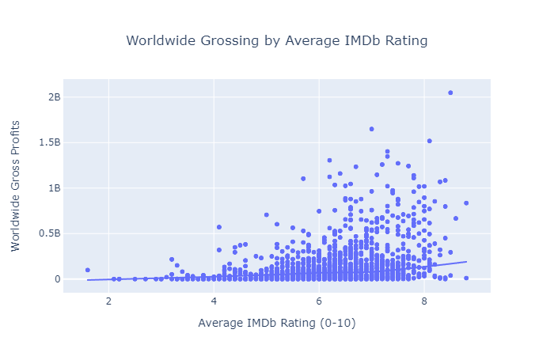
Overall ratings of movies do not have a significant effect on profit
This supports not basing movie-making choices on online ratings

Slide 11
Does a movie’s runtime affect profitability?
3

Slide 12
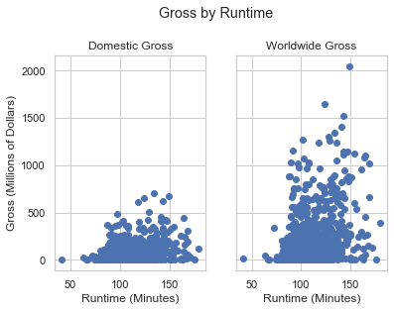
As long as a movie is more than 75 minutes long, length does not seem to impact profit.
Movies over 75 minutes in length are the most profitable.
I recommend only considering length when making a movie to ensure that it is more than 75 minutes long.

Slide 13
Conclusion
Making action, animation, sci-fi, and/or adventure movies increases the likelihood of making large profits. However multiple other genres are also continuing to bring in impressive box offices.
Online rating systems such as IMDB do not accurately reflect the viability of a movie.
Once runtime hits approximately 75 minutes, it is not an important predictor of profit.

Slide 14
Future Work
Franchises are an integral part of the movie industry’s profit. What attributes do successful franchises share?
Which audiences prefer what types of movies? Does this differ between domestic and international moviegoers?
What story attributes beyond genre are related to higher movie profitability?

Slide 15
Thanks!

Slide 16
Credits
Special thanks to all the people who made and released these awesome resources for free:
Presentation template by SlidesCarnival
Photographs by Unsplash

Slide 17
Appendix

Slide 18
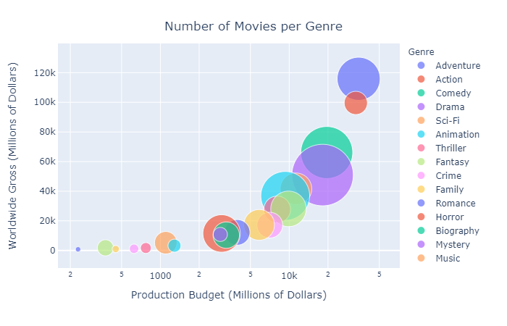
How many movies of each genre are getting made?

